Slide 1


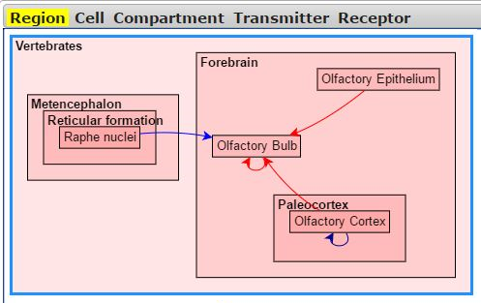
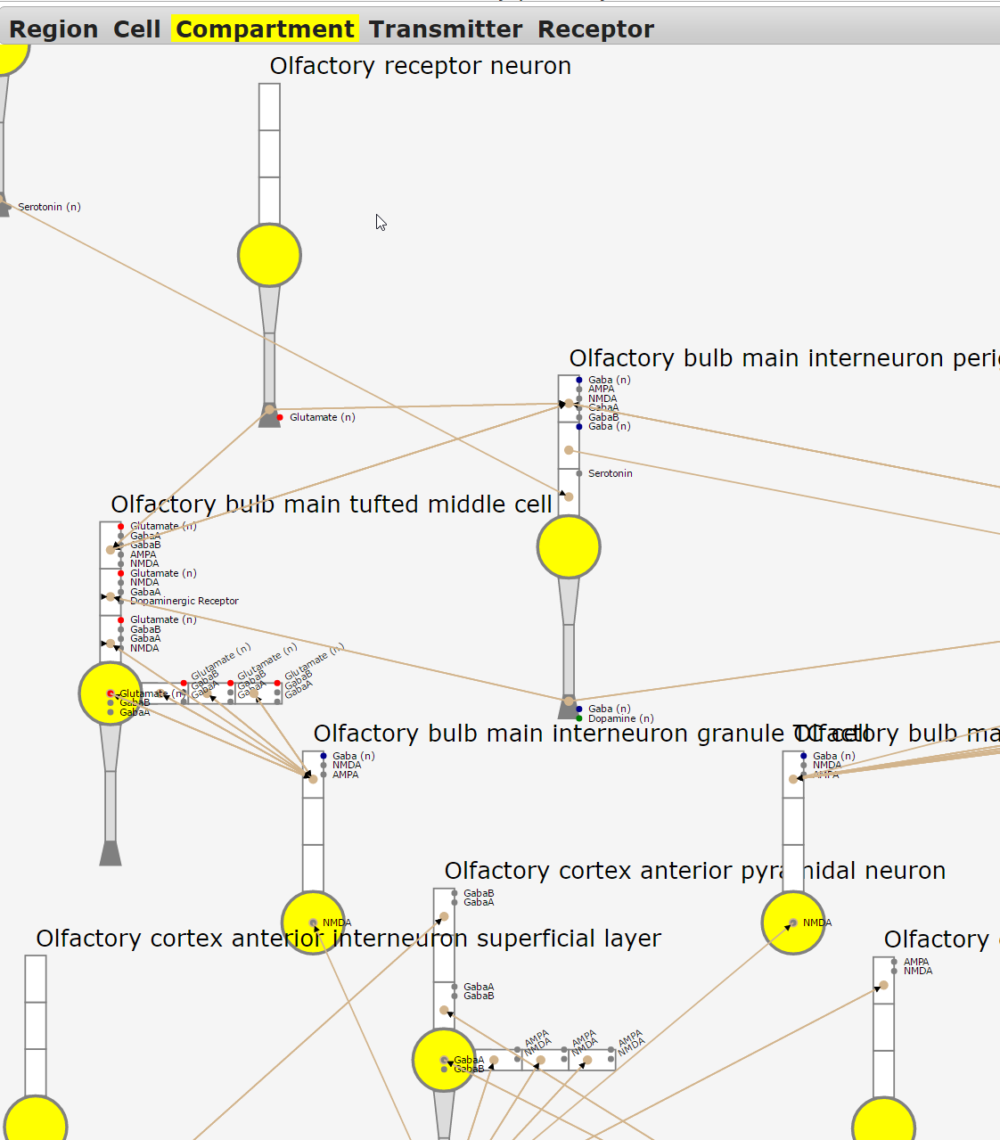
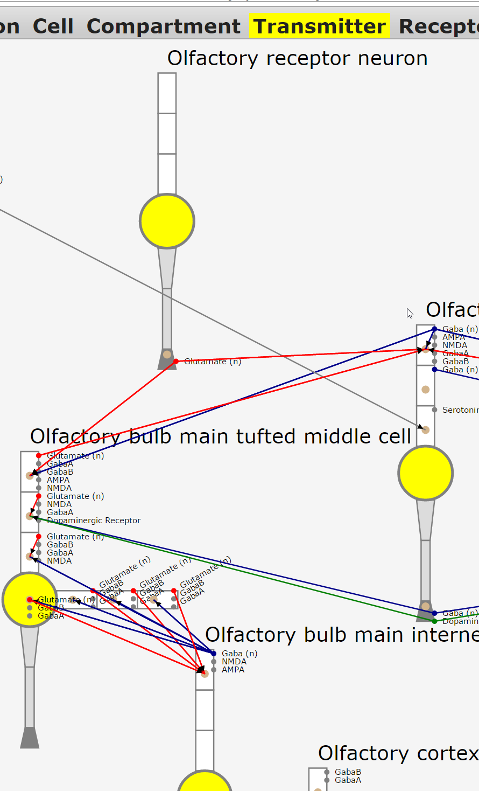
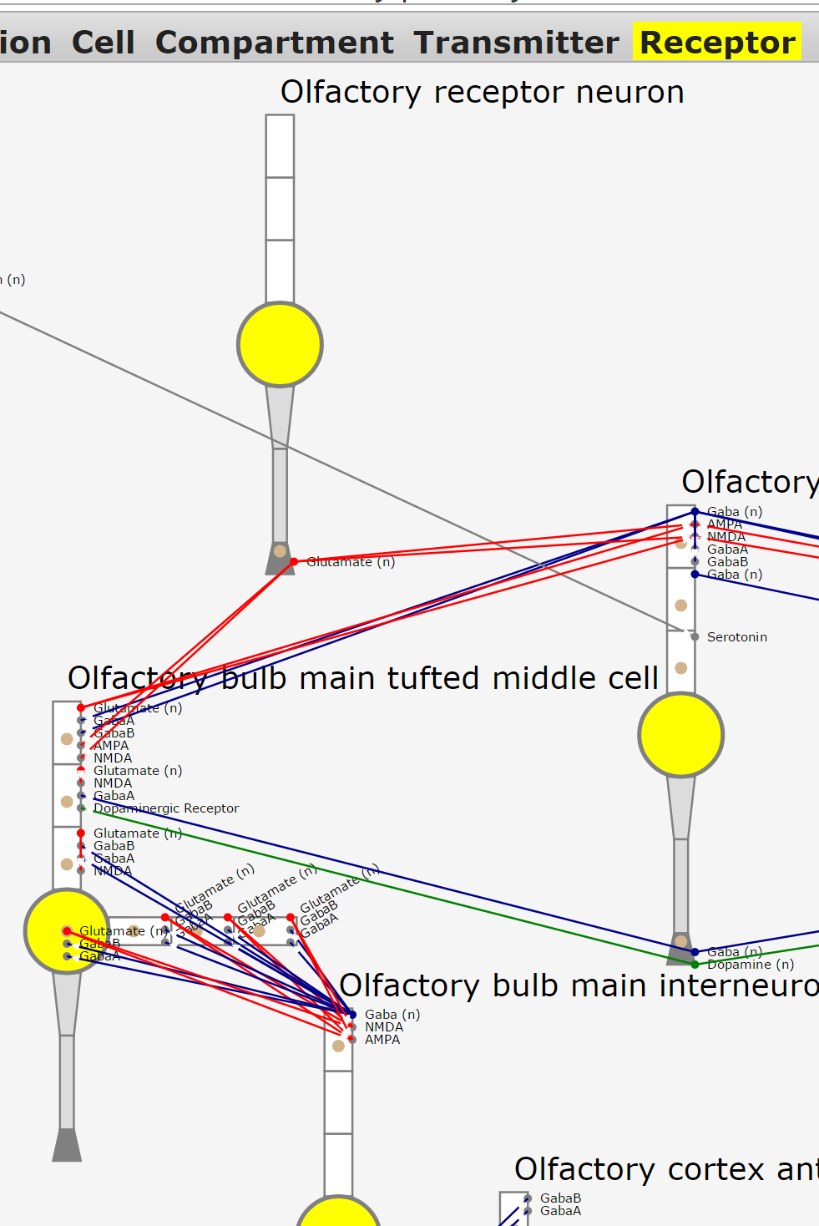
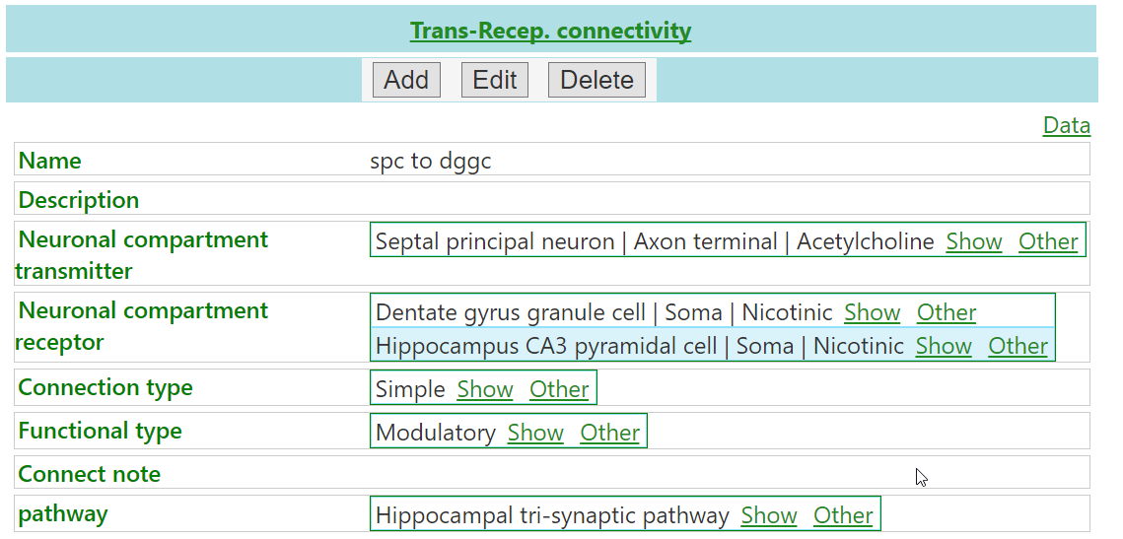
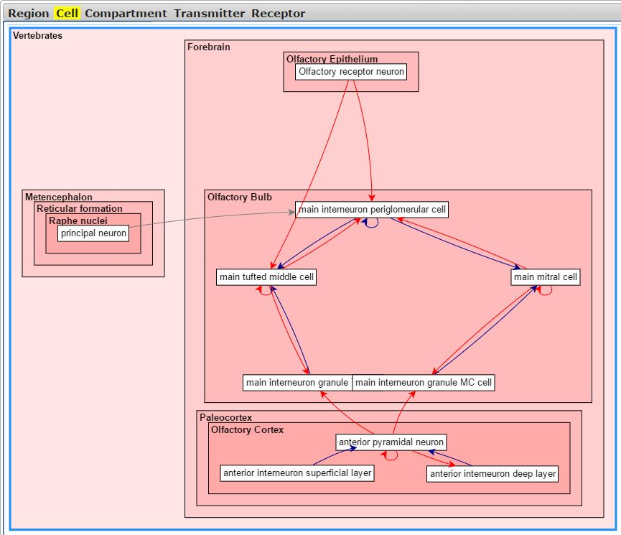
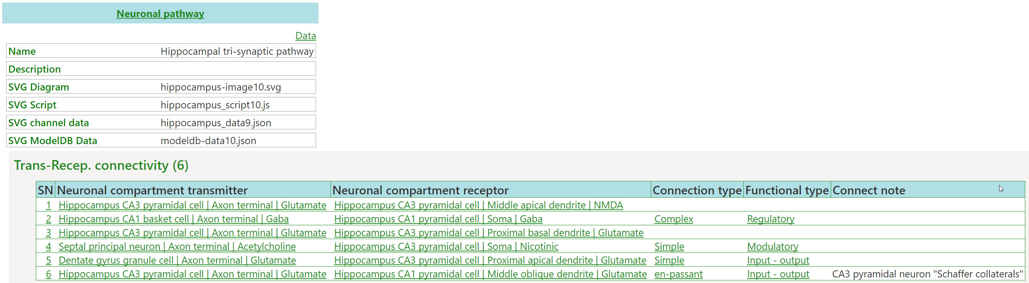
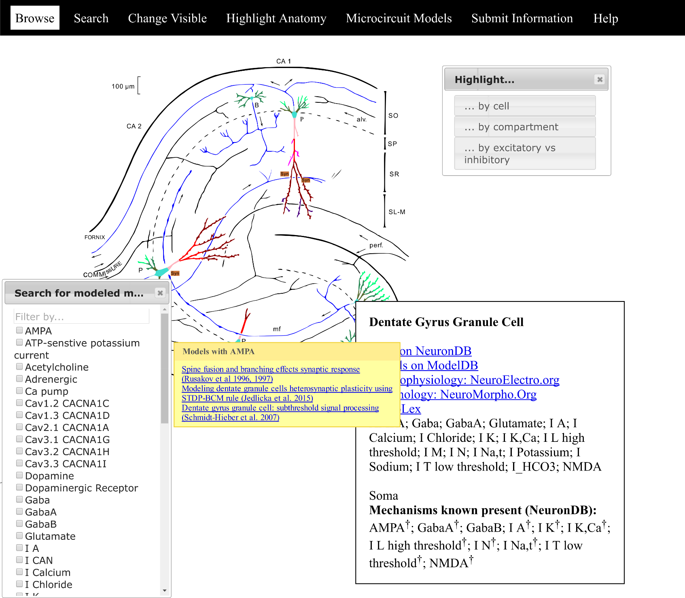
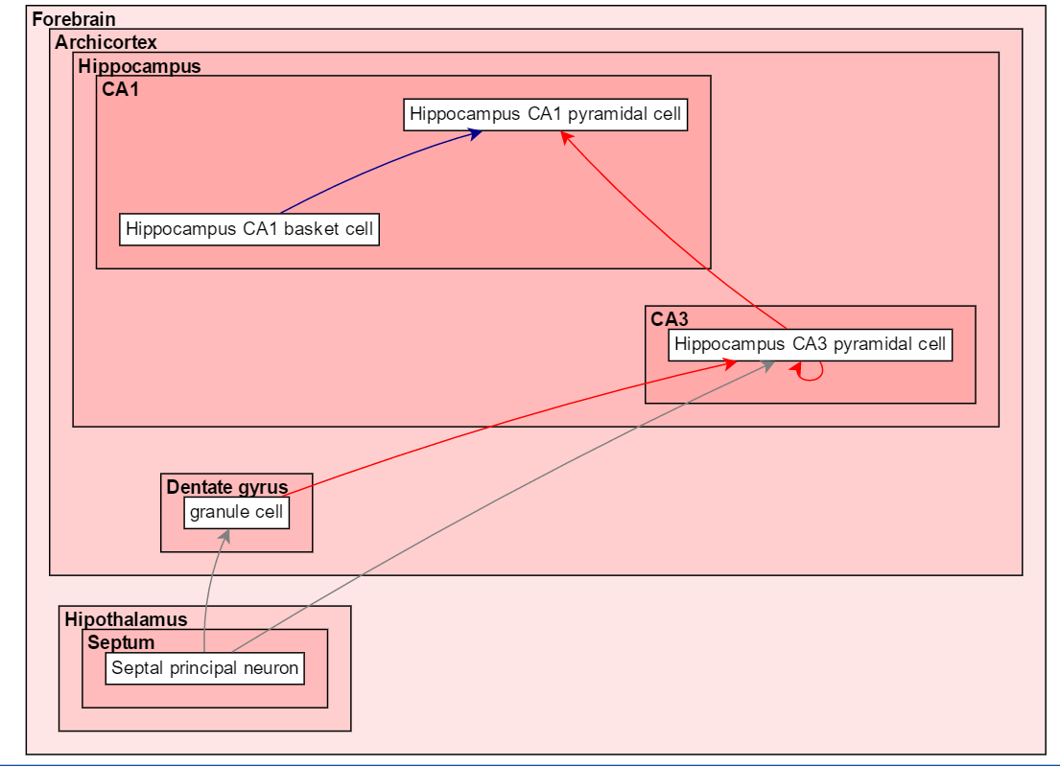
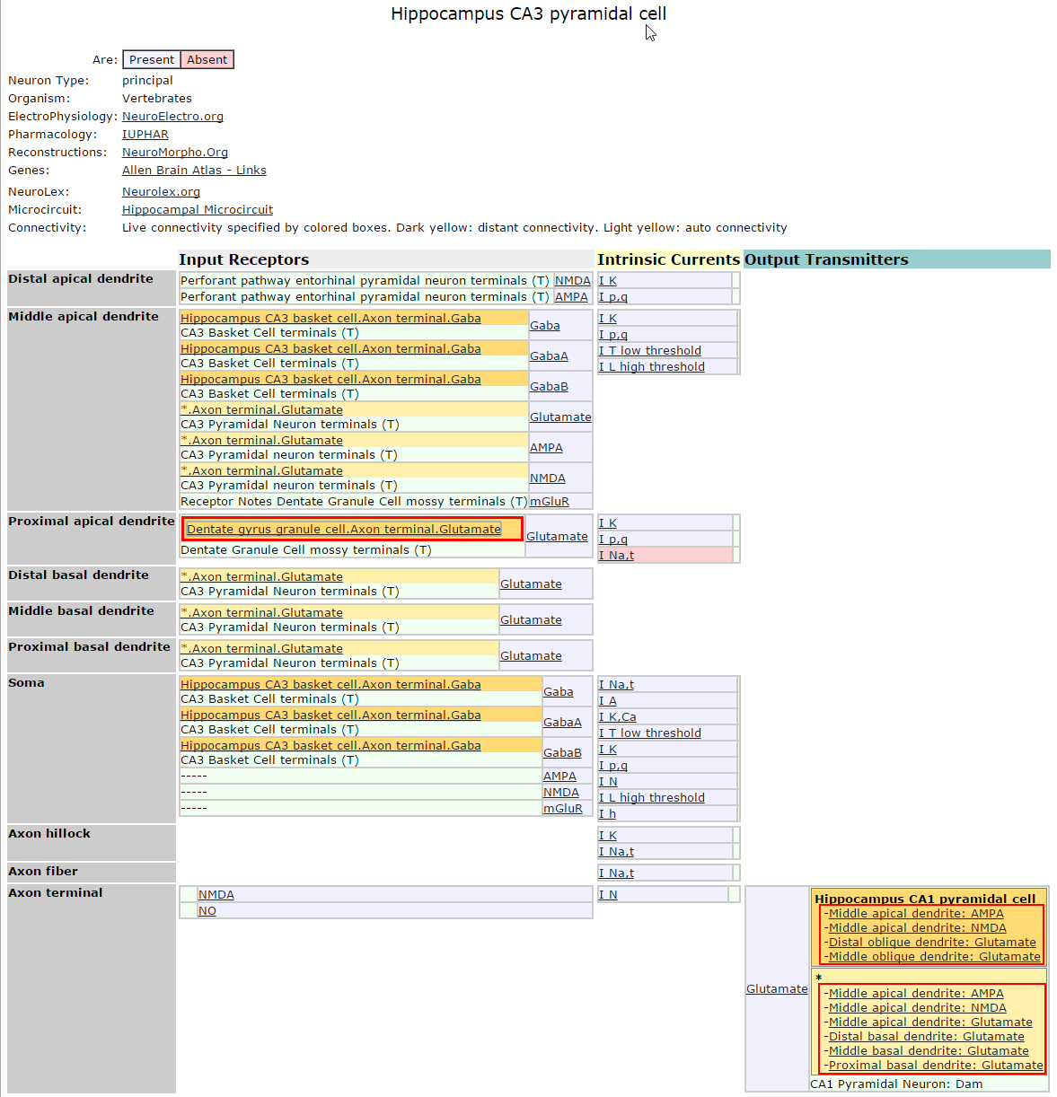
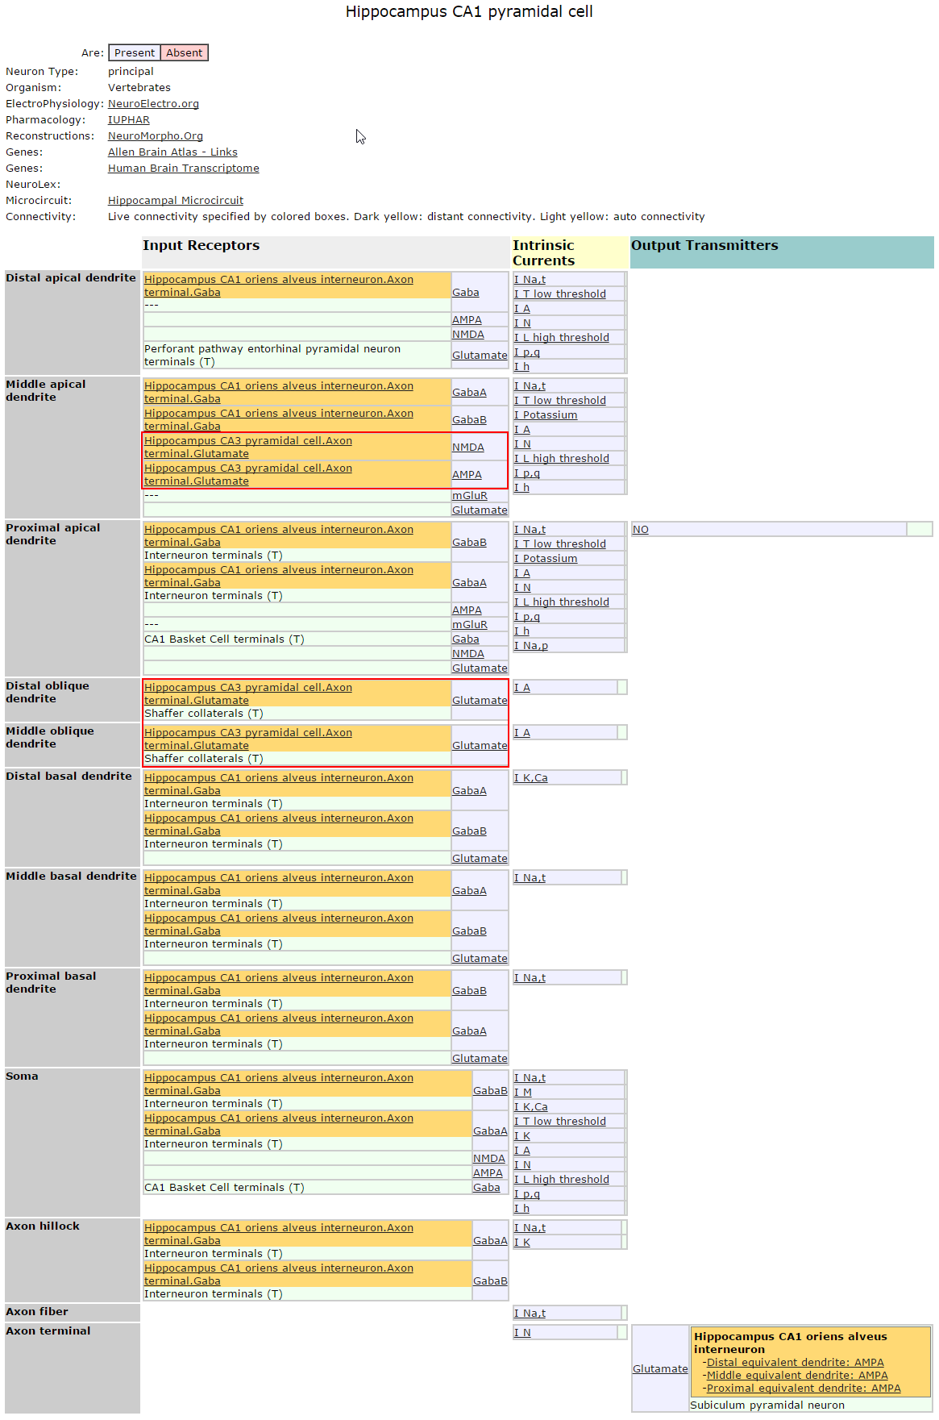
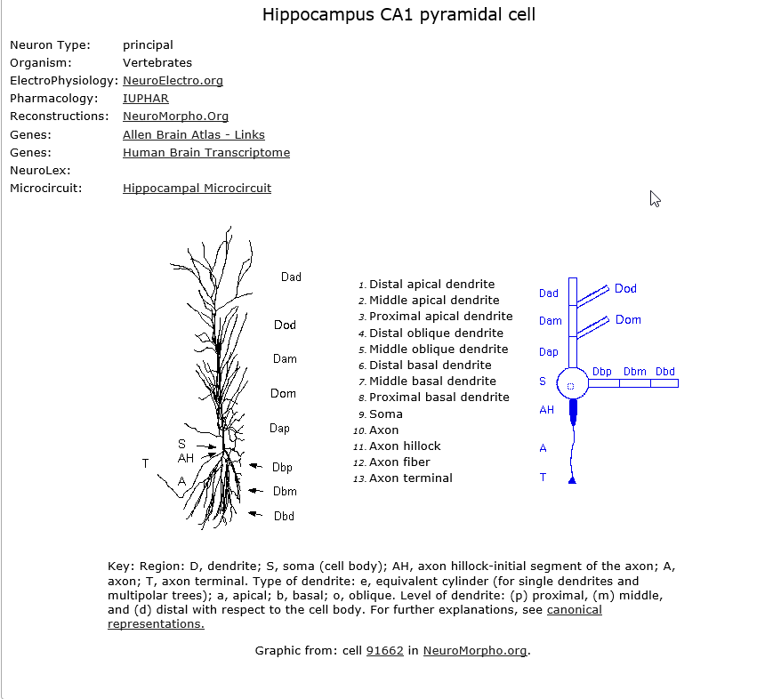
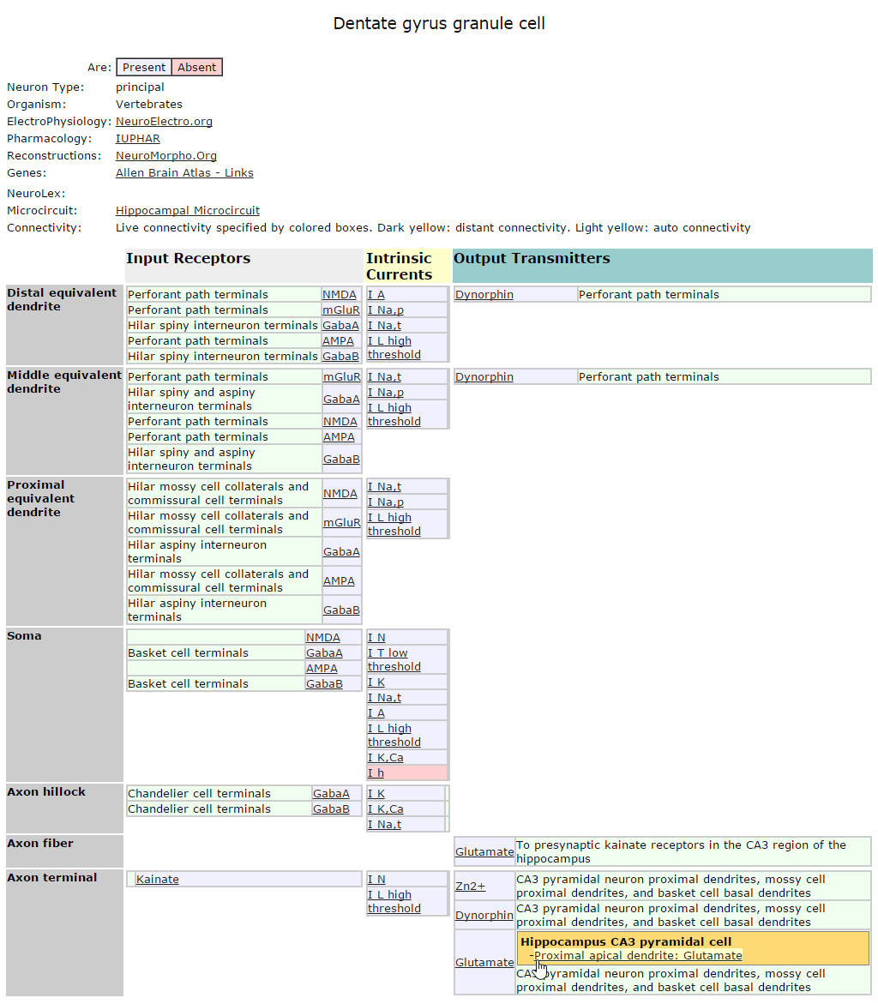
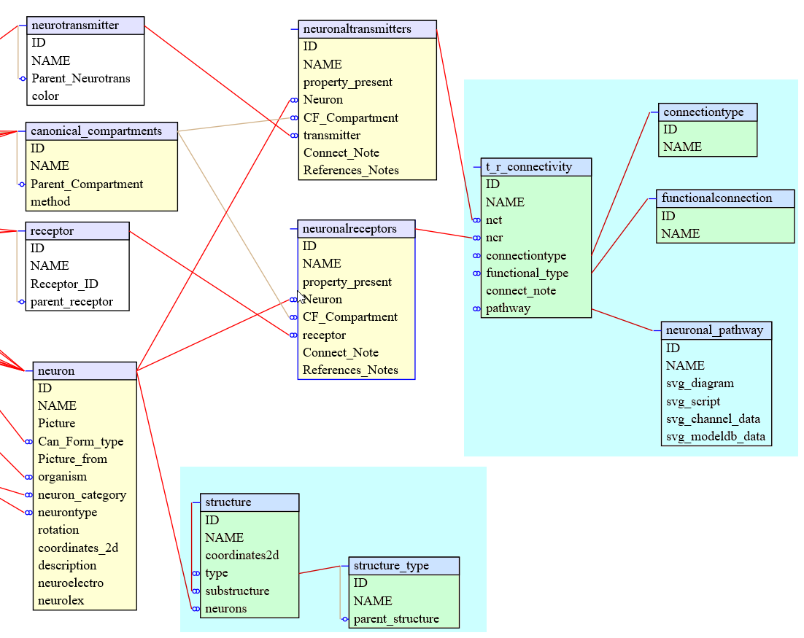
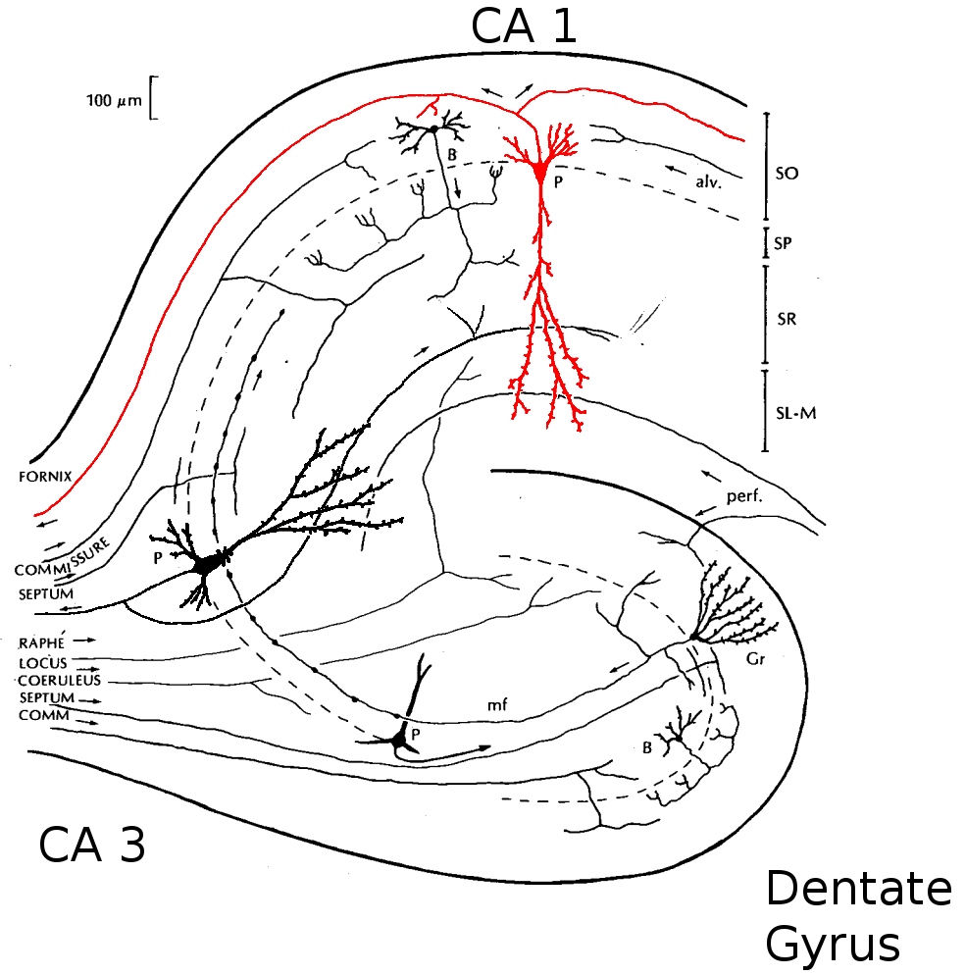
Development of FunctionalConnectomeDB within SenseLab to incorporate and mine functional connectomics data
Luis Marenco^{1,2,4}, Rixin Wang¹, Robert A. McDougal^{1,2}, Thomas M. Morse², N. Ted Carnevale², Perry Miller^{1,3,4}, Gordon M. Shepherd²
¹ Medical Informatics, ² Neuroscience, ³ Anesthesiology, Yale, University School of Medicine New Haven, CT; ⁴VA Connecticut HealthCare System, West Haven, CT
470.17
OOO10
ABSTRACT
In order to foster discovery, in recent years the SenseLab group has enhanced neuronal content by incorporating functional connectivity information. This information, often referred to as connectomics, is fueled by research on fiber tracts and interconnectivity within brain regions. To overcome the difficulties posed by mining the highly interdisciplinary content within connectomics data, SenseLab has created several techniques to share, navigate, query and represent this information. For data sharing, we use domain-specific data models that are exposed using common internet formats such as JSON. For querying and display we have created innovative realistic microconnectome-enhanced diagrams, as well as continued to develop metadata-driven canonical diagrams. All our components (data, messaging, and client tools) are built using separation of concern principles, as independent tools that can be used separately one from each other, and with similar components from other projects. SenseLab, as an interoperable suite of databases, also supports research on dendritic properties and synaptic organization. Building on the SenseLab extensible data model, we have successfully extended our domain to incorporate the new connectivity details at the neuronal compartment level. Previously we described this information in NeuronDB, but challenges by the complexity of the information, and how to query and navigate it, required the creation of a new database, FunctionalConnectomeDB. This new resource for connectomics data in SenseLab, besides providing connectivity information, also integrates its information with that in our other neuronal databases. Current categories of information in FunctionalConnectomeDB include: a) Microcircuit; b) Brain Regions, c) Neuron: type (principal and interneurons), canonical form and compartments, and relative size; and d) Synapses: transmitter type released from a cell compartment (e.g. glutamate from an axon terminal) and receptor type activated from a cell compartment (e.g. NMDA receptor in a proximal dendrite).
Introduction
SenseLab stores the properties present in neuronal compartments by subdividing the compartments into regions such as proximal (to the soma), middle, and distal apical dendrites. These subdivisions are defined in canonical neurons.
The canonical neuron compartment maps retain just enough specificity of spatial localization to represent the variation present in the observed expression of membrane proteins of interest (receptors, channels). We added connectivity links to these properties.
Background
The connections between the cells in the brain are daunting to track.
We have prototyped a new method to browse connectivity, using the olfactory pathway and hippocampus microcircuits to demonstrate the principles:
Visualizing connections
A new tool visualizes connectivity at multiple levels of resolution and provides the ability to change between spatial scales: from brain regions, to cells, to cellular compartments and their transmitters and receptors; the Olfactory pathway is shown for each of these levels below.
Visualizes: spatial localization, direction, colored coded neurotransmitter actions, and at the more detailed compartmental level: specific neurotransmitters and receptors in their specific compartments.
Process
Once the specific neuronal-compartment-transmitter and -receptor properties have been populated we go to the transmitter receptor connectivity class to specify the specific neuronal compartmental transmitters and the neuronal compartmental receptors it connects to. We can add to the pathway all connectomes in which this connection participates.
A parallel representation of the Trisynaptic pathway and its data-driven diagram. Note in the diagram on the right glutamatergic connections in red and GABAergic in blue. These types of connections are further classified and color coded as: input-output, Modulatory and Regulatory.
Future plans
Visuals
Improving compartment, transmitter and receptor views, and including regions
Exploring 3D rendering using 3DModelDB and external data
Functional
Interacting dashboard: Present factors that may affect the connectivity (drugs, genes, pathological, etc.)
Microcircuit connectivity: inputs/outputs
Hierarchical functional units: e.g. compartments, multiple cells acting as a unit
Data Sharing / Collaboration.
Enhancing existing api’s for sharing our connectomics data with external users and resources.
Incorporating external data into our current tools to complement the information to our users.
Building better connectomics visualization tools:
Existing visualization tools are too specific for their statistical purposes. Building a neuro-connectivity dashboard requires a new visualization tool that will combine functionality available from existing diagraming tools as well as tools specific to neuroscience.
Technologies
Windows 2012R2, SQL server 2012, IIS, C#, Razor, HTML5, JQuery. For some diagrams we used a demo version of go.js from nwoods.com
Navigating the Connectome
NeuronDB provides neuronal properties including neuronal connectivity at the compartmental level.
These images show a schematic view of cell connectivity in NeuronDB and where links lead from one to another.
Specific subsets of these connections participate in specific connectomes. Highlighted in red are some related to the trisynaptic pathway.
Some connectomes can be very complex and difficult to describe using this presentation model.
To facilitate connectome representation we are exploring new ways including structured and realistic diagrams.
Implementation
SenseLab uses the EAVCR data model, and OO database implementation approach that facilitates domain evolution and robust data interface generation.
The diagram below shows highlighted in blue, recent database changes we made to implement connectivity. These changes are in continuous revision as we keep adding necessary information to store connectivity.
Visualizing tools and NeuronDB pages rely on this information to generate their content.
Conclusions:
This new resource is providing us with new mechanisms to explore different ways to represent and study connectome information at different levels.
Taking advantage of the domain flexibility of our system, we plan to incorporate new dimensions of data that could include species, developmental stages, and disease. This will include a plan to correlate and analyze how behavior of these pathways may be influenced.
This new resource can be used by experimentalists, modelers, and students to become aware of the interacting combinations of connectivity with excitatory/inhibitory synaptic transmission, intrinsic currents, and cell morphology.
FunctionalConnectomeDB mapping connections within regions will connect with initiatives mapping connections between regions to provide a united Brain Connectome.
Acknowledgement
We are grateful for support by research grant R01 DC 00997701 from the National Institute for Deafness and Other Communicative Disorders and from T15 LM 007056 from the National Library of Medicine.
luis.marenco@yale.edu

