Slide 1


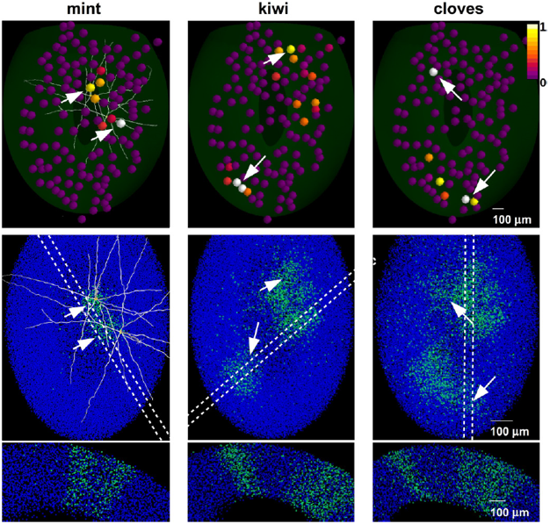
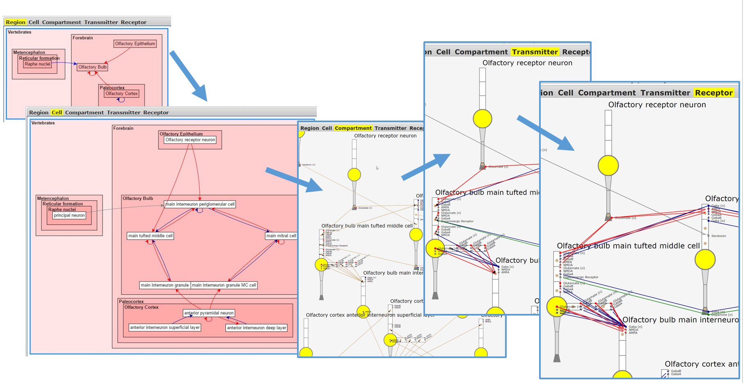
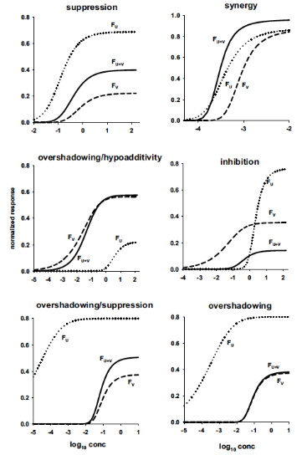
Discovering neuronal interactions,
models and properties by browsing microcircuits
in multiple spatial scales
Luis N. Marenco¹, Rixin Wang², Robert A. McDougal¹, Francesco Cavarretta^{1,4},
Monique Surles-Zeigler², Thomas M. Morse¹, Michele Migliore^{1,4}, N. Ted Carnevale¹,
Michael L. Hines¹, Perry Miller^{2,3}, Gordon M. Shepherd¹
¹Neuroscience Department, ²Center for Medical Informatics, Yale University, New Haven CT ³VA Connecticut Healthcare System, West Haven, CT
⁴Institute of Biophysics, National Research Council, Palermo, Italy
INCF booth
Neuroinformatics and olfactory research developments
A microcircuit browser enables a Neuroscientist to explore experimental
investigations and models of neural networks, cells, and ion channels and
receptors.
A new tool helps modelers by suggesting keywords for a model they are
contributing to modeldb by detecting related phrases in the abstract.
A new method predicts,
when given an olfactory
sensory neuron’s response
to two or more odors, what
the mixture of arbitrary
concentrations of these
odors would produce
in that olfactory sensory
neuron.
A multiscale diagram viewer produces views of brain regions, or cells
within regions or properties (transmitters, receptors, ion channels) within
cells (excitatory - red, inhibitory - blue).
A 3D olfactory bulb model using experimentally observed
odor responses as inputs to stimulations with learning rules
were found to create columns similar to those previously
observed with histology.
The SenseLab group gratefully acknowledges support from
NIH grant R01 DC009977 and NIH grant T15 LM007056.

